Slide 1
Unit 4 Testing of hypothesis

Slide 2
Concept and types of hypothesis-Null and Alternative hypothesis,
Hypothesis is an educated prediction that can be tested.
Statistical procedure of evaluating hypothesis about population characteristics on the basis of sample observation is called testing of hypothesis.
The measures usually of interest are mean, standard deviation, variance, correlation, regression coefficient etc

Slide 3
Null hypothesis (H₀): A hypothesis is formulated for the purpose of rejecting or accepting it. For example, hypothesis can be tested to examine whether a given coin is biased, then the null hypothesis becomes
H₀:P=0.5, where P is the probability of getting head in a toss. Suppose a hypothesis is set up to test whether there is a significant difference between means of two populations. Then the null hypothesis becomes H₀: μ₁= μ₂

Slide 4
Alternative hypothesis: Any hypothesis that differs from the null hypothesis is alternative hypothesis. For example, if H₀:P=0.5 then alternative hypothesis could be H₁:P≠0.5.
Errors in testing hypothesis: When a statistical hypothesis is tested it is either accepted or rejected. In both cases wrong decision or errors can be committed. Suppose a null hypothesis is accepted, but it is not true in reality or a hypothesis is rejected but it is true in reality.
In both decision or errors are made. Type 1 error is committed when a true null hypothesis is rejected and type II error is committed when a false hypothesis is accepted.
The probability of type error is known as level of significance and denoted by α and probability of type II error is denoted by β.

Slide 5
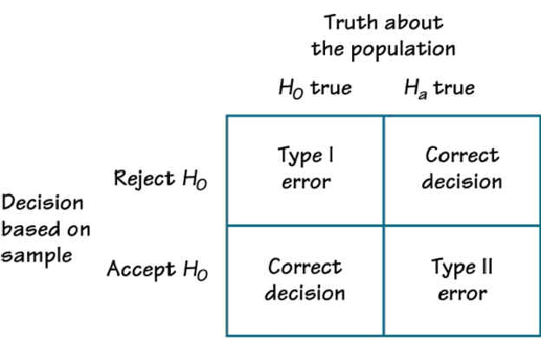

Slide 6
1- β is called the power of a statistical test
In testing hypothesis, it is desired to minimize both errors of making wrong decisions.
Therefore, the usual practice is to fix α and increase the sample size for making β as small as possible. Usually, values of α are taken as 0.05, 0.1 or 0.01. This means that 5% chance of making type 1 error is tolerated if α=0.05.

Slide 7
P-value: P value is a probability of value of a test statistic in testing of hypothesis. More specifically, it is the probability value for which null hypothesis is rejected if it is less than α. If P-value is greater than α, null hypothesis is accepted.
For instance, in testing a hypothesis based on t –distribution, if computed value is 2.5 so that the corresponding p values for two tailed test at 20 degrees of freedom is 0.0212 is less than 0.05., then this mean that null hypothesis is rejected at 5% level of significance since is 0.0212 is less than 0.05.
Any P-value greater than 0,05 suggest to accept null hypothesis at 5% level of significance. The same principle can applied in any other statistical test.

Slide 8

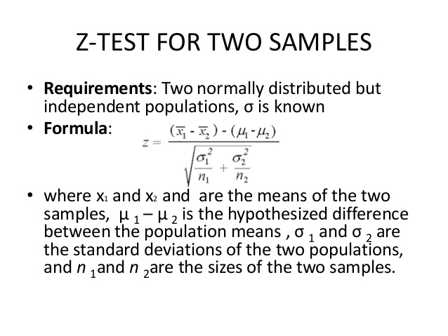
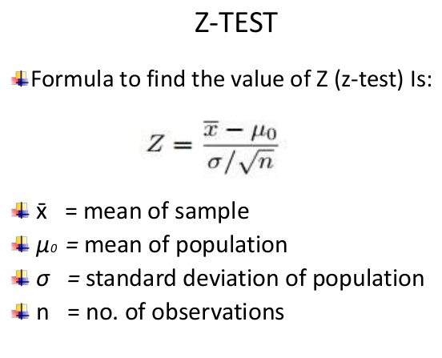
Z-test
Several testing of hypothesis are done using Z distribution
Df= n₁+n₂-2

Slide 9

Example: The results of the study found the following:
For the drug group, the mean score on the ESP test was 9.78, S.D. = 4.05, n = 900
For the no-drug group, the mean = 15.10, S.D. = 4.28, n= 1000
Example: Jessica is 15 years old and 66.41 in. tall but for 15 year old girls, μ = 63.8, σ = 2.66, Compare using Z-test

Slide 10
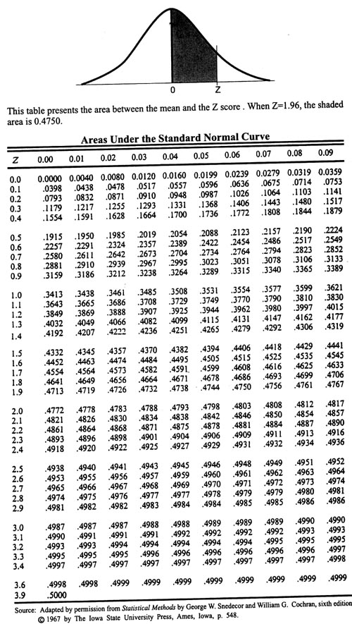
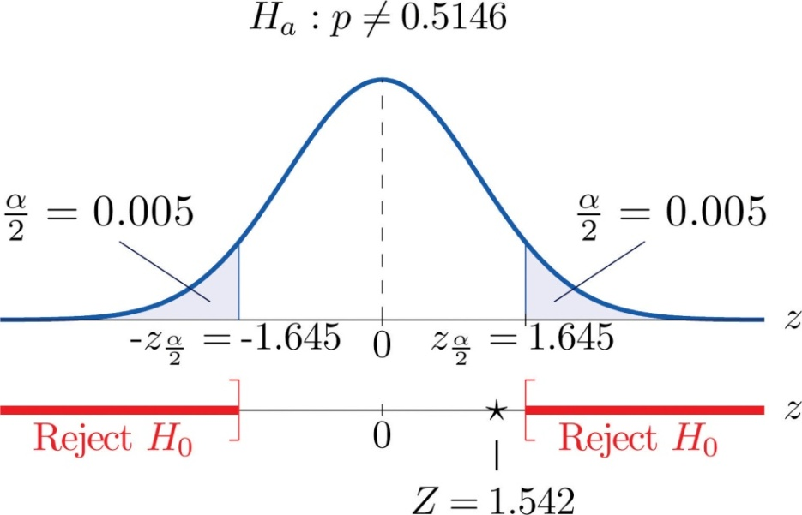
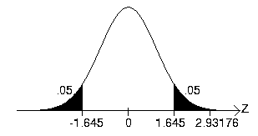
Z- Critical value | α=1% | α=5% | α=10%
2tailed test | 2.575 | 1.96 | 1.645
Right tailed test | 2.33 | 1.645 | 1.28
Left tailed test | -2.33 | -1.645 | -1.28

Slide 11
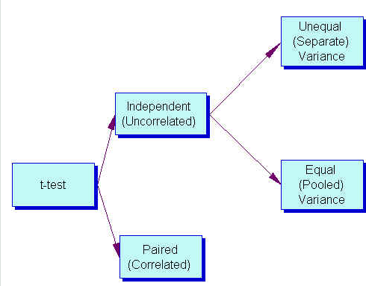
hypothesis testing: t-test

Slide 12
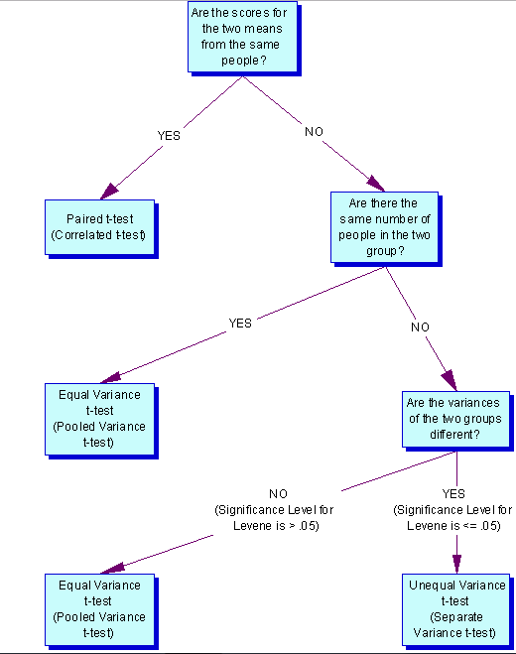

Slide 13

One-sample t-test formula
As mentioned above, one-sample t-test is used to compare the mean of a population to a specified theoretical mean (μ).
Let X represents a set of values with size n, with mean m and with standard deviation S. The comparison of the observed mean (m) of the population to a theoretical value μμ is performed with the formula below :
To evaluate whether the difference is statistically significant, you first have to read in t test table the critical value of Student’s t distribution corresponding to the significance level alpha of your choice (5%). The degrees of freedom (df) used in this test are :
df=n−1

Slide 14
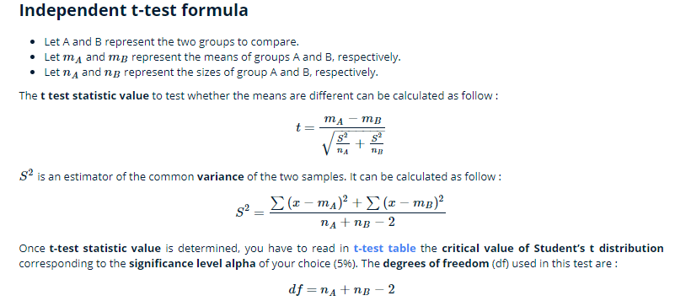
Independent two sample t-test
Independent (or unpaired two sample) t-test is used to compare the means of two unrelated groups of samples.
As an example, we have a cohort of 100 individuals (50 women and 50 men). The question is to test whether the average weight of women is significantly different from that of men?
In this case, we have two independents groups of samples and unpaired t-test can be used to test whether the means are different.

Slide 15
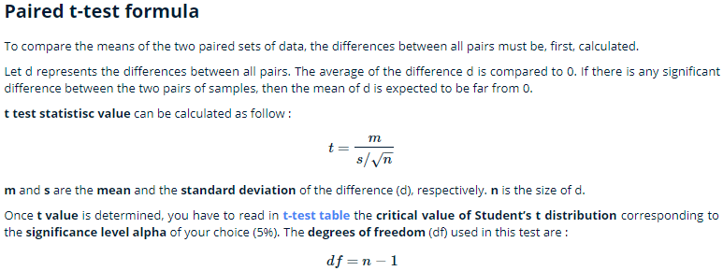
Paired sample t-test
Paired Student’s t-test is used to compare the means of two related samples. That is when you have two values (pair of values) for the same samples.
For example, 20 mice received a treatment X for 3 months. The question is to test whether the treatment X has an impact on the weight of the mice at the end of the 3 months treatment. The weight of the 20 mice has been measured before and after the treatment. This gives us 20 sets of values before treatment and 20 sets of values after treatment from measuring twice the weight of the same mice.
In this case, paired t-test can be used as the two sets of values being compared are related. We have a pair of values for each mouse (one before and the other after treatment).

Slide 16

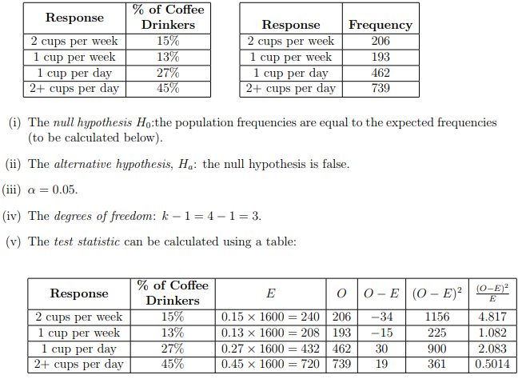
Non parametric tests (Chi-square test),

Slide 17
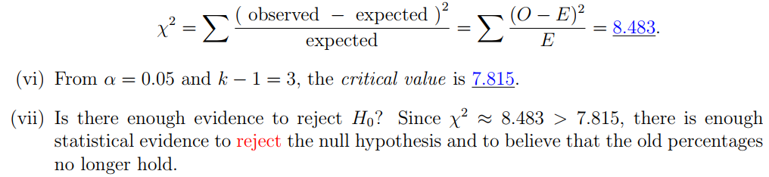
Example 2: A department store, A, has four competitors: B,C,D, and E. Store A hires a consultant to determine if the percentage of shoppers who prefer each of the five stores is the same. A survey of 1100 randomly selected shoppers is conducted, and the results about which one of the stores shoppers prefer are below. Is there enough evidence using a significance level α = 0:05 to conclude that the proportions are really the same?
Store | A | B | C | D | E
Number of Shoppers | 262 | 234 | 204 | 190 | 210
Practice Problem 1: A doctor believes that the proportions of births in this country on each day of the week are equal. A simple random sample of 700 births from a recent year is selected, and the results are below. At a significance level of 0.01, is there enough evidence to support the doctor’s claim?
Day | Sunday | Monday | Tuesday | Wednesday | Thursday | Friday | Saturday
Frequency | 65 | 103 | 114 | 116 | 115 | 112 | 75

Slide 18
Thurston scale and Likert Technique
Thurstone scales: The Thurstone scale is made up of statements about a particular issue and each statement has a numerical value indicating the repsondent’s attitude about the issue, either favorable or unfavorable.
People indicate which of the statements with that they agree and the average response is computed.

Slide 19
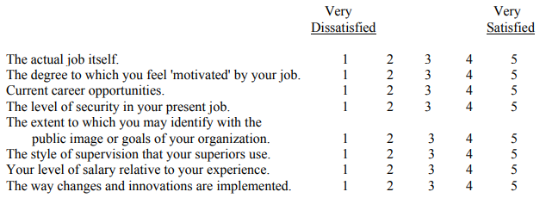
Likert, Likert-type, or Summated Rating Scales
Likert, Likert-type, or Summated Rating Scales: Individuals without tremendous expertise are able to develop sophisticated measures using the Likert method for developing scales.
Although originally developed with a number of statements in which individuals indicated their extent of agreement with response choices such as 1 = disagree, 2 = disagree somewhat, 3= neither agree nor disagree, 4 = agree somewhat, 5 = agree, statements with other response choices such as unimportant to important can be used.

Slide 20
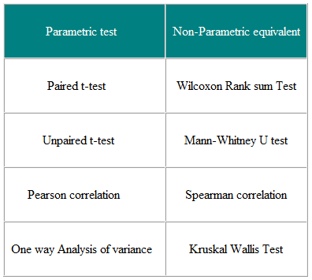
List of parametric and non parametric tests

Slide 21
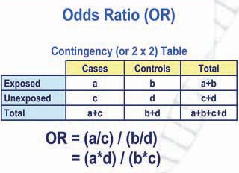
Odd ratio
The Odds Ratio is a measure of association which compares the odds of disease of those exposed to the odds of disease those unexposed.

Slide 22
 |  | Controls (not fills)
 | Cases
 |  |  | Total
Exposed | 5 | 3 | 8
Unexposed | 2 | 10 | 12
 | 7 | 13 | 20
Odds of exposure in cases = a/c = 5/2 = 2.5
Odds of exposure in controls = b/d = 3/10 = 0.3
Odds Ratio = (a/c) / (b/d) = 2.5/0.3 = 8.33
Interpretation: What does this mean?
OR of 1 would suggests that there is no difference between the groups; i.e. there would be no association between the suggested exposure (fish) and the outcome (being ill)
OR of > 1 suggests that the odds of exposure are positively associated with the adverse outcome compared to the odds of not being exposed
OR of < 1 suggests that the odds of exposure are negatively associated with the adverse outcomes compared to the odds of not being exposed. Potentially, there could be a protective effect

Slide 23
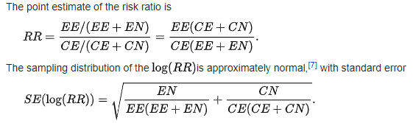
Risk ratio
In epidemiology, risk ratio (RR) or relative risk is the ratio of the probability of an outcome in an exposed group to the probability of an outcome in an unexposed group.
Risk ratio can be estimated from a 2x2 contingency table:
The point estimate of the risk ratio is
 | Group
 | Experimental (E) | Control (C)
Events (E) | EE | CE
Non-events (N) | EN | CN

Slide 24
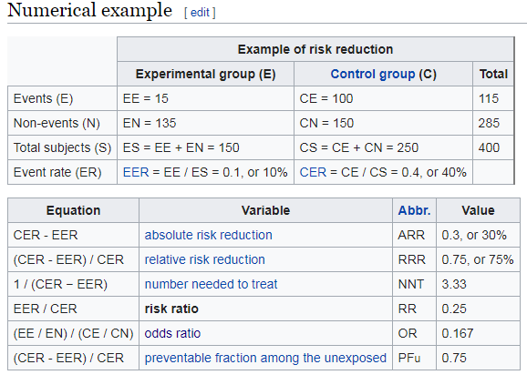

Slide 25
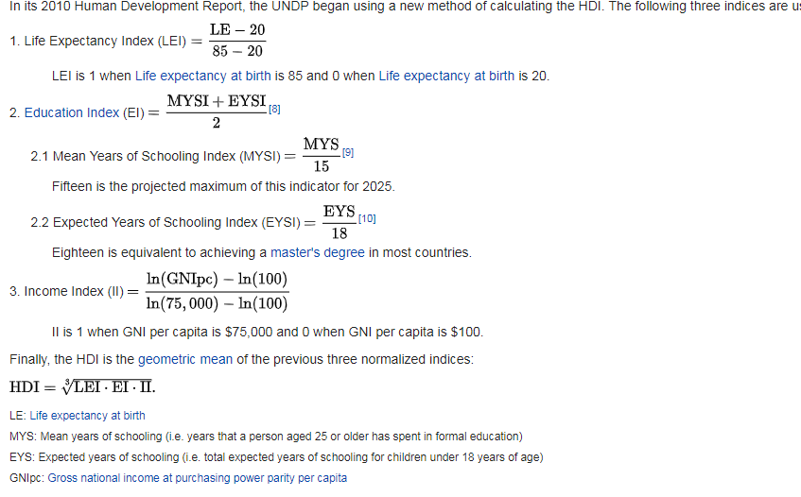
Development index
The Human Development Index (HDI) then represents the uniformly weighted sum with ​¹⁄₃contributed by each of the following factor indices:

Slide 26
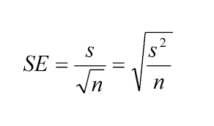
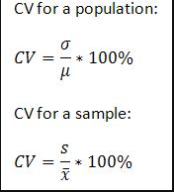
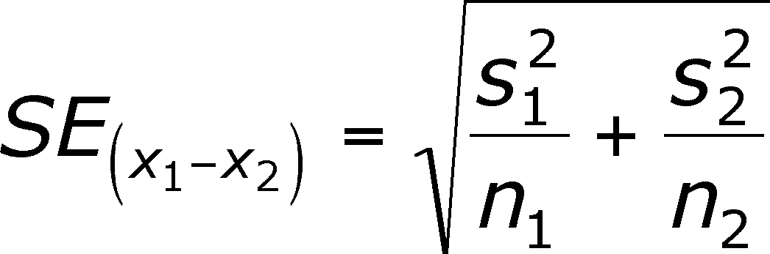
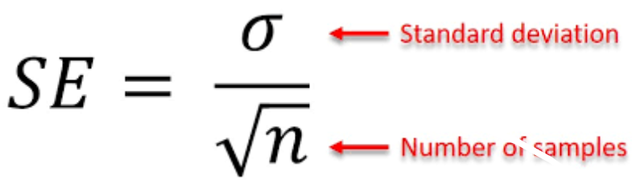
THANKS

Slide 27
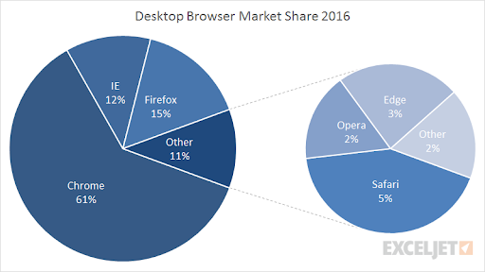
Application of pie chart
Pie charts are designed to visualize how a whole is divided into various parts. Each segment of the pie is a particular category within the total data set. In this way, it represents a percentage distribution.
Use: The pie chart is primarily used to illustrate how different parts make up a whole. The best way to present your data in a pie chart is to compare the categories with each other. The following comparison words can be used interchangeably:

Slide 28
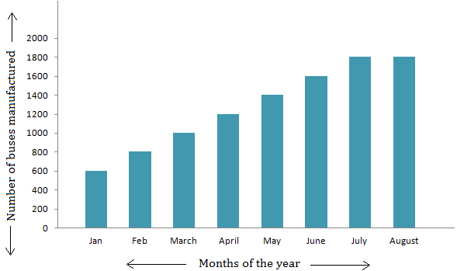
BR DIAGRAM
Bar graphs are used to show relationships between different data series that are independent of each other. In this case, the height or length of the bar indicates the measured value or frequency. Below, you can see the example of a bar graph which is the most widespread visual for presenting statistical data.
How to describe bar graphs
Bar graphs transform the data into separate bars or columns. Generally, this type of visuals have categories on the x-axis and the numbers on the y-axis. So, you can compare statistical data between different groups.
The bar graphs show which category is the largest and which is the smallest one. Each group should be independent so that the changes in one do not influence others. The bars or columns can be drawn either vertically or horizontally, as it doesn’t make any difference.

Slide 29
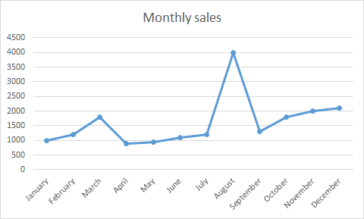
Line graphs
Line graphs represent how data has changed over time. This type of charts is especially useful when you want to demonstrate trends or numbers that are connected. For example, how sales vary within one year. In this case, financial vocabulary will come in handy. Besides, line graphs can show dependencies between two objects during a particular period.
To express the movement of the line, you should use appropriate verbs, adjectives, and adverbsdepending on the kind of action you need to show. For this, you should use the following vocabulary:
Verbs: rise, increase, grow, go up to, climb, boom, peak, fall, decline, decrease, drop, dip, go down, reduce, level up, remain stable, no change, remain steady, stay constant, stay, maintain the same level, crash, collapse, plunge, plummet.

Slide 30
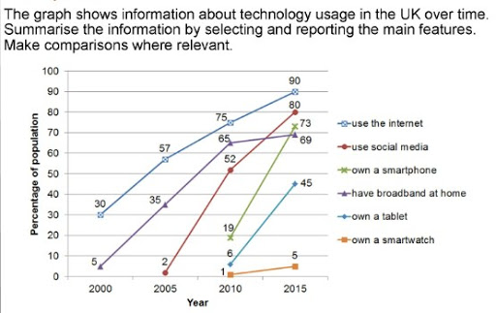
Multiple lines

Slide 31
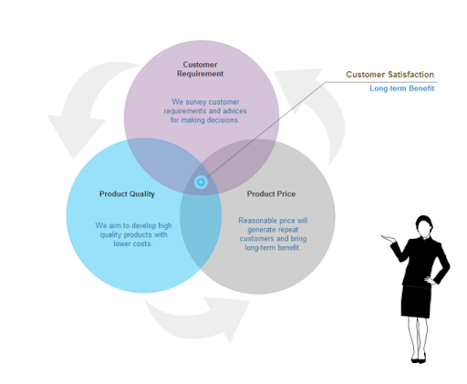
Diagram
Diagram is a plan, drawing, or outline created to illustrate how separate parts work and overlap at the connecting points

Slide 32
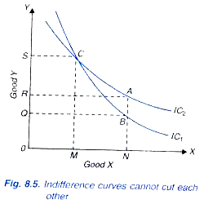
Other diagram

Slide 33
THANKS

